Slide 1
E-mail Security: PGP and S/MIME

Slide 2
 |  | Outline
 |  | PGP Services Message format Key management Trust management S/MIME Services Message formats Ley management | 2

Slide 3
 |  | What is PGP?
 |  | PGP (Pretty Good Privacy) It is a general purpose application to protect (encrypt and/or sign) files. It can be used to protect e-mail messages. It can be used by corporations as well as individuals. It is based on strong cryptographic algorithms (IDEA, RSA, SHA-1). It is available free at http://www.pgpi.org The developed by Phil Zimmermann. PGP is now on an Internet standards track (RFC 3156). 3

Slide 4
 |  | PGP services
 | PGP / services | Messages Authentication Confidentiality Integrity Ccompression E-mail compatibility Segmentation and reassembly Key management Generation, distribution, and revocation of public/private keys. Generation and transport of session keys and Ivs. 4

Slide 5
Confidentiality and Authentication

Slide 6



 |  | Message authentication
 | PGP / services | Based on digital signatures Supported algorithms: RSA/SHA and DSS/SHA - ^{K}snd m h σ hash enc m h h σ hash compare dec ^{K}snd accept / reject 5
sender
receiver

Slide 7




 |  | Message confidentiality
 | PGP / services | Symmetric key encryption in CFB mode with a random session key and IV. Session key and IV is encrypted with the public key of the receiver. Supported algorithms: Symmetric: CAST, IDEA, 3DES Asymmetric: RSA, ElGamal m prng Krcv {k, iv}_{Krcv} s.enc a.enc k, iv {m}_{k} 6
sender

Slide 8
 |  | Compression
 | PGP / services | Applied after the signature Enough to store clear message and signature for later verification. It would be possible to dynamically compress messages before signature verification, but … Then all PGP implementations should use the same compression algorithm. However, different PGP versions use slightly different compression algorithms. Applied before encryption compression reduces redundancy → makes cryptanalysis harder Supported algorithm: ZIP 7

Slide 9
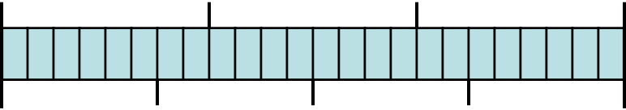
 |  | E-mail compatibility
 | PGP / services | Encrypted messages and signatures may contain arbitrary octets. Most e-mail systems support only ASCII characters. PGP converts an arbitrary binary stream into a stream of printable ASCII characters. Radix 64 conversion: 38-bit blocks → 46-bit blocks 0 7 0 7 0 7 0 5 0 5 0 5 0 5 6-bit character 6-bit character value encoding value encoding 0 A 52 0 … ... … … 25 Z 61 9 26 a 62 + … … 63 / 51 z (pad) = ₈

Slide 10
 |  | Transmission of PGP Message
 | PGP / services

Slide 11
 |  | PGP message format
 | PGP / message format
{ }Krcv
{ }Ksnd⁻¹
ZIP
{ }_{k}
R64

Slide 12
 |  | Key IDs
 | PGP / key and trust management | A user may have several public key – private key pairs Which private key to use to decrypt the session key? Which public key to use to verify a signature? Transmitting the whole public key would be wasteful. Associating a random ID to a public key would result in management burden. PGP key ID: least significant 64 bits of the public key Unique within a user with very high probability. 11

Slide 13
 |  | Random Number Generation
 | PGP / key and trust management | True random numbers Used to generate public key – private key pairs. Provide the initial seed for the pseudo-random number generator (PRNG). Provide additional input during pseudo-random number generation. Pseudo-random numbers Used to generate session keys and IVs. 12

Slide 14
 |  | True random numbers
 | PGP / key and trust management | PGP maintains a 256-byte buffer of random bits. Each time PGP expects a keystroke from the user, it records. The time when it starts waiting (32 bits) The time when the key was pressed (32 bits) The value of the key stroke (8 bits) The recorded information is used to generate a key. The generated key is used to encrypt the current value of the random-bit buffer. 13

Slide 15
 |  | Pseudo-random numbers
 | PGP / key and trust management | Based on the ANSI X9.17 PRNG standard K₁, K₂ DT_{i} 3DES + V_{i} + 3DES R_{i} | 3DES | ^{V}i+1 14

Slide 16
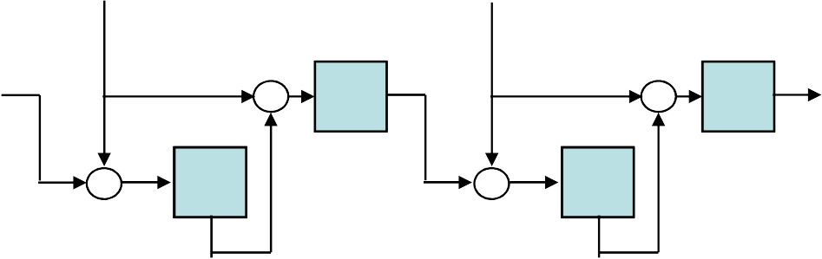
 |  | Pseudo-random numbers
 | PGP / key and trust management | dtbuf _{E} rseed + true random bits CAST-12 | + E E + + IV[0..7] 8 is used instead | + E E + K[8..15] of 3DES with | + ey r | E + K[0.. key | + E 7] | rseed’ 15

Slide 17
 |  | Pseudo-random numbers
 | PGP / key and trust management | dtbuf[0..3] = current time, dtbuf[4..7] = 0 Pre-wash Take the hash of the message This has already been generated if the message is being signed Otherwise, the first 4K of the message is hashed. Use the result as a key, use a null IV, and encrypt (rkey, rseed)_{previous} in CFB mode. If (rkey, rseed)_{previous} is empty, it is filled up with true random bits. Set (rkey, rseed)_{current} to the result of the encryption. Post-wash Generate 24 more bytes as before but without XORing in true random bytes. Encrypt the result in CFB mode using K and IV. Set (rkey, rseed)_{previous} to the result of the encryption. 16

Slide 18

 |  | Private-key ring
 | PGP / key and trust management | Used to store the public key – private key pairs owned by a given user Essentially a table, where each row contains the following entries: Timestamp Key ID (indexed) Public key Encrypted private key User ID (indexed) private key passphrase hash enc encrypted private key 17

Slide 19
 |  | Public-key ring
 | PGP / key and trust management | Used to store public keys of A table, where each row timestamp key ID (indexed) public key user ID (indexed) owner trust signature(s) signature trust(s) key legitimacy | other users contains the following entries: 18

Slide 20
Key Ring (PGP Message Generation)

Slide 21
PGP Message Reception

Slide 22
 |  | Trust management
 | PGP / key and trust management | Owner trust Assigned by the user Possible values: unknown user usually not trusted to sign usually trusted to sign always trusted to sign ultimately trusted (own key, present in private key ring) Signature trust Assigned by the PGP system. If the corresponding public key is already in the public-key ring, then its owner trust entry is copied into signature trust. Otherwise, signature trust is set to unknown user. 19

Slide 23
 |  | Trust management
 | PGP / key and trust management | Key legitimacy Computed by the PGP system. If at least one signature trust is ultimate, then the key legitimacy is 1 (complete). Otherwise, a weighted sum of the signature trust values is computed Always trusted signatures has a weight of 1/X. Usually trusted signatures has a weight of 1/Y. X, Y are user-configurable parameters. Example: X=2, Y=4 1 ultimately trusted, or 2 always trusted, or 1 always trusted and 2 usually trusted, or 4 usually trusted signatures are needed to obtain full legitimacy 20

Slide 24
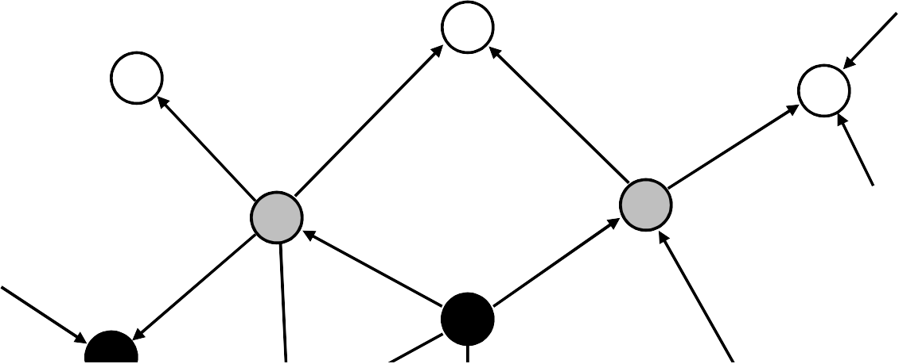
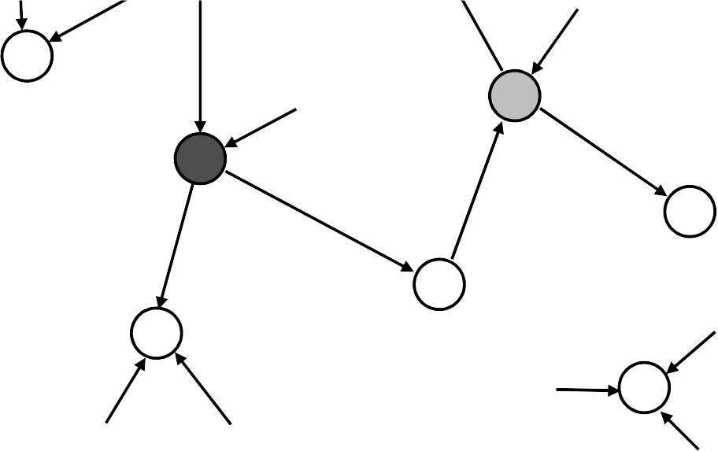
 |  | Example – key legitimacy
 | PGP / key and trust management | X = 1, Y = 2 G F untrusted / usually untrusted usually trusted always trusted ultimately trusted | B _{A} | C user E L | _{D} J | H I | K M 21

Slide 25
 |  | Public-key revocation
 | PGP / key and trust management | Why to revoke a public key? Suspected to be compromised (private key got known by someone) Re-keying The owner issues a revocation certificate … has a similar format to normal public-key certificates contains the public key to be revoked signed with the corresponding private key And disseminates it as widely and quickly as possible If a key is compromised: e.g., Bob knows the private key of Alice Bob can issue a revocation certificate to revoke the public key of Alice even better for Alice 22

Slide 26
 |  | What is S/MIME?
 |  | Secure / Multipurpose Internet Mail Extension A security enhancement to MIME Provides similar services to PGP Based on technology from RSA Security Industry standard for commercial and organizational use RFC 2630, 2632, 2633 23

Slide 27
 |  | RFC 822
 | S/MIME / introduction | Defines a format for text messages to be sent using e-mail Internet standard structure of RFC 822 compliant messages header lines (e.g., from: …, to: …, cc: …) blank line body (the text to be sent) Example Date: Tue, 16 Jan 1998 10:37:17 (EST) From: “Levente Buttyan” <buttyan@hit.bme.hu> Subject: Test To: afriend@otherhost.bme.hu Hello! 24

Slide 28
 |  | Problems with RFC 822 and SMTP
 | S/MIME / introduction | Executable files must be converted into ASCII various schemes exist (e.g., Unix UUencode) a standard is needed Text data that includes special characters (e.g., Hungarian text). Some servers Reject messages over a certain size. Delete, add, or reorder CR and LF characters. Truncate or wrap lines longer than 76 characters. Remove trailing white space (tabs and spaces). Pad lines in a message to the same length. Convert tab characters into multiple spaces. 25

Slide 29
 |  | MIME
 | S/MIME / introduction | Defines new message header fields Defines a number of content formats standardizing representation of multimedia contents) Defines transfer encodings that protects the content from alteration by the mail system. 26

Slide 30
 |  | MIME - New header fields
 | S/MIME / introduction | MIME-Version Content-Type Describes the data contained in the body Receiving agent can pick an appropriate method to represent the content Content-Transfer-Encoding Indicates the type of the transformation that has been used to represent the body of the message Content-ID Used to identify MIME entities uniquely in multiple contexts. Content-Description Description of the object in the body of the message Useful when content is not readable (e.g., audio data) 27

Slide 31
 |  | MIME – Content types and subtypes
 | S/MIME / introduction | Text/plain, text/enriched Image/jpeg, image/gif Video/mpeg Audio/basic Application/postscript, application/octet-stream Multipart/mixed, multipart/parallel, multipart/alternative, multipart/digest (each part is message/rfc822) Message/rfc822, message/partial, message/external-body 28

Slide 32
 |  | MIME – Transfer encodings
 | S/MIME / introduction | 7bit short lines of ASCII characters 8bit short lines of non-ASCII characters binary non-ASCII characters lines are not necessarily short quoted-printable non-ASCII characters are converted into hexa numbers (e.g., =EF) base64 (radix 64) 38-bit blocks into 46-bit blocks x-token non-standard encoding 29

Slide 33
 |  | MIME – Example
 | S/MIME / introduction | MIME-Version: 1.0 From: Nathaniel Borenstein <nsb@nsb.fv.com> To: Ned Freed <ned@innosoft.com> Date: Fri, 07 Oct 1994 16:15:05 -0700 (PDT) Subject: A multipart example Content-Type: multipart/mixed; boundary=unique-boundary-1 This is the preamble area of a multipart message. Mail readers that understand multipart format should ignore this preamble. If you are reading this text, you might want to consider changing to a mail reader that understands how to properly display multipart messages. --unique-boundary-1 Content-type: text/plain; charset=US-ASCII … Some text … --unique-boundary-1 Content-Type: multipart/parallel; boundary=unique-boundary-2 --unique-boundary-2 Content-Type: audio/basic Content-Transfer-Encoding: base64 ... base64-encoded 8000 Hz single-channel mu-law-format audio data goes here ... --unique-boundary-2 Content-Type: image/jpeg Content-Transfer-Encoding: base64 ... base64-encoded image data goes here ... --unique-boundary-2-- 30

Slide 34
 |  | MIME – Example cont’d
 | S/MIME / introduction | --unique-boundary-1 Content-type: text/enriched This is <bold><italic>enriched.</italic></bold><smaller>as defined in RFC 1896</smaller> Isn’t it <bigger><bigger>cool?</bigger></bigger> --unique-boundary-1 Content-Type: message/rfc822 From: (mailbox in US-ASCII) To: (address in US-ASCII) Subject: (subject in US-ASCII) Content-Type: Text/plain; charset=ISO-8859-1 Content-Transfer-Encoding: Quoted-printable ... Additional text in ISO-8859-1 goes here ... --unique-boundary-1-- 31

Slide 35
 |  | S/MIME services
 | S/MIME / services | Enveloped data (application/pkcs7-mime; smime-type = enveloped-data) This consists of encrypted content of any type and encrypted content encryption keys for one or more recipients. Signed data (application/pkcs7-mime; smime-type = signed-data) standard digital signature (“hash and sign”) content + signature is encoded using base64 encoding a signed data message can only be viewed by a recipient with S/MIME capability. Clear-signed data (multipart/signed) standard digital signature only the signature is encoded using base64 recipient without S/MIME capability can read the message but cannot verify the signature Signed and enveloped data signed and encrypted entities may be nested in any order 32

Slide 36
 |  | Cryptographic algorithms
 | S/MIME / services | Message digest must: SHA-1 should (receiver): MD5 (backward compatibility) Digital signature must: DSS should: RSA Asymmetric-key encryption must: ElGamal should: RSA Symmetric-key encryption sender: should: 3DES, RC2/40 receiver: must: 3DES should: RC2/40 33

Slide 37
 |  | Securing a MIME entity
 | S/MIME / services | MIME entity is prepared according to the normal rules for MIME message preparation. Prepared MIME entity is processed by S/MIME to produce a PKCS object. The PKCS object is treated as message content and wrapped in MIME. 34

Slide 38

 |  | PKCS7 “signed data”
 | S/MIME / message formats | Version (Set of) Digest Algorithms Content Info Set of certificates Set of CRLs Signer Info | Content type Content Version Signer ID (issuer and ser. no.) Digest Algorithm Authenticated Attributes Digest Encryption Alg. Encrypted digest (signature) | 35

Slide 39

 |  | PKCS7 “enveloped data”
 | S/MIME / message formats | Version Originator Info Recipient Info Encrypted Content Info | Version Recipient ID (issuer and s.no.) Key Encryption Algorithm Encrypted Key Content type Content Encryption Alg. Encrypted Content 36

Slide 40
 |  | Enveloped data – Example
 | S/MIME / message formats | Content-Type: application/pkcs7-mime; smime-type=enveloped-data; name=smime.p7m Content-Transfer-Encoding: base64 Content-Disposition: attachment; filename=smime.p7m rfvbnj756tbBghyHhHUujhJhjH77n8HHGT9HG4VQpfyF467GhIGfHfYT6 7n8HHGghyHhHUujhJh4VQpfyF467GhIGfHfYGTrfvbnjT6jH7756tbB9H f8HHGTrfvhJhjH776tbB9HG4VQbnj7567GhIGfHfYT6ghyHhHUujpfyF4 0GhIGfHfQbnj756YT64V 37

Slide 41
 |  | Clear-signed data – Example
 | S/MIME / message formats | Content-Type: multipart/signed; protocol="application/pkcs7-signature"; micalg=sha1; boundary=boundary42 --boundary42 Content-Type: text/plain This is a clear-signed message. --boundary42 Content-Type: application/pkcs7-signature; name=smime.p7s Content-Transfer-Encoding: base64 Content-Disposition: attachment; filename=smime.p7s ghyHhHUujhJhjH77n8HHGTrfvbnj756tbB9HG4VQpfyF467GhIGfHfYT6 4VQpfyF467GhIGfHfYT6jH77n8HHGghyHhHUujhJh756tbB9HGTrfvbnj n8HHGTrfvhJhjH776tbB9HG4VQbnj7567GhIGfHfYT6ghyHhHUujpfyF4 7GhIGfHfYT64VQbnj756 --boundary42--

Slide 42
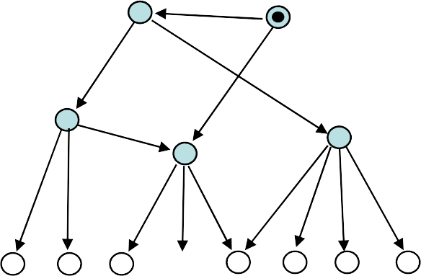
 |  | Key management
 | S/MIME / key management | S/MIME certificates are X.509 conformant Key management scheme is between strict certification hierarchy and PGP’s web of trust Certificates are signed by certification authorities (CA). Key authentication is based on chain of certificates. Users/managers are responsible to configure their clients with a list of trusted root keys. K 39

